Slide 1
ANM ANOMALY DETECTION CHALLENGE FALL 2019
DAVIDE LIU AND SHUBH VACHHER
TSINGHUA UNIVERSITY

Slide 2
OVERVIEW
DATA VISUALIZATION
DATA PREPROCESSING
MODELS TESTED
RESULTS

Slide 3


DATA VISUALIZATION

Slide 4
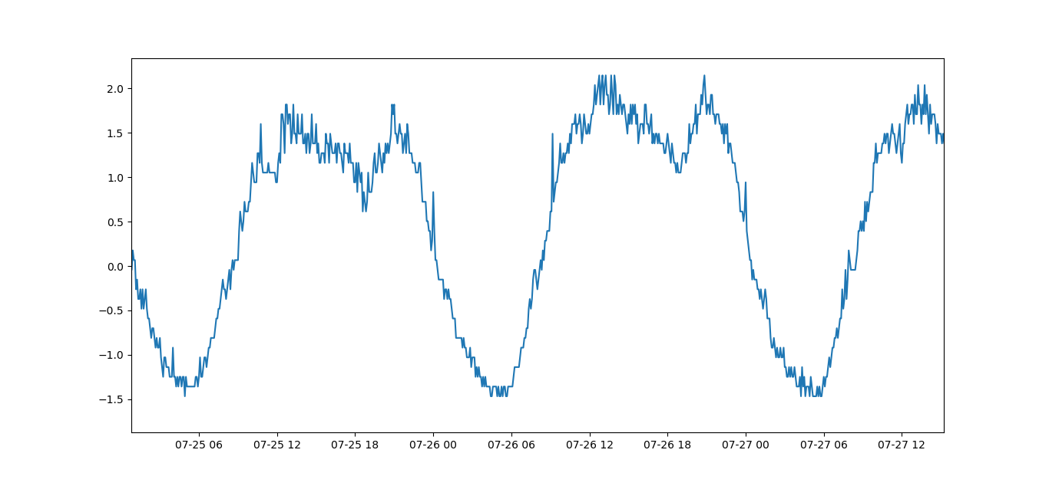
Visualizing Daily Trend

Slide 5
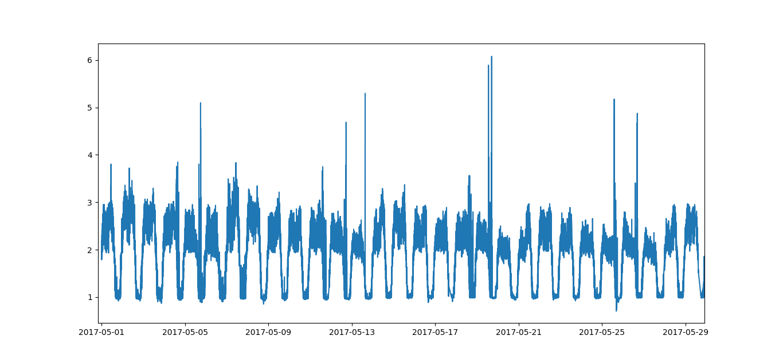
Visualizing Weekly Trend

Slide 6
DATA PREPROCESSING

Slide 7
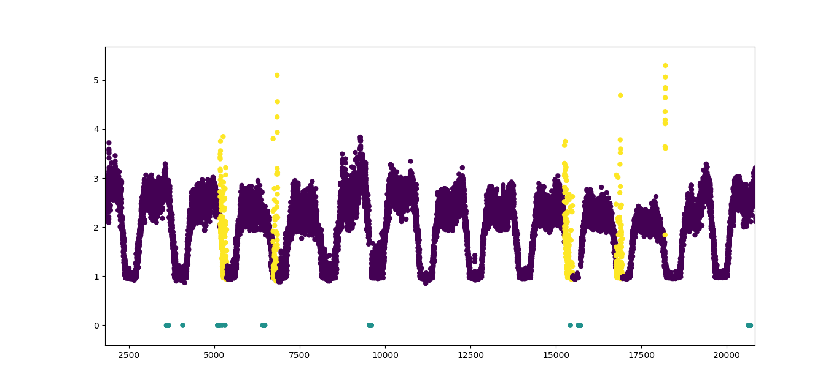
Visualizing KPI with Missing Points and Anomalies

Slide 8
Data Preprocessing
Divide data into 26 KPIs
Create different model for each KPI
Filling missing timestamps
Tried interpolation and filling with zeros
Data Standardization
Mean and Standard deviation used to scale the data

Slide 9
Models Trained

Slide 10
DONUT

Slide 11
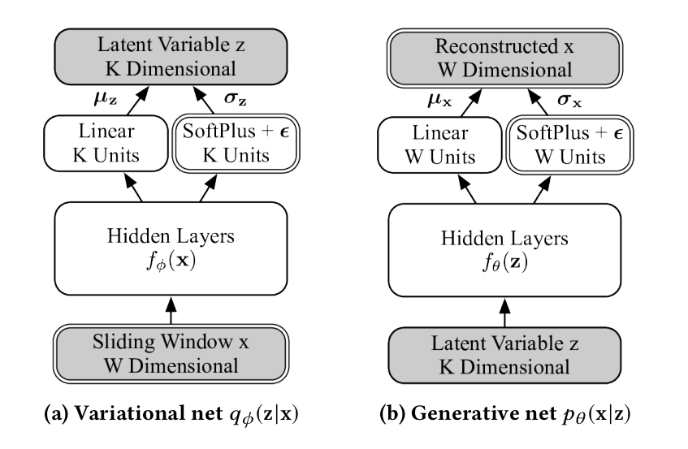
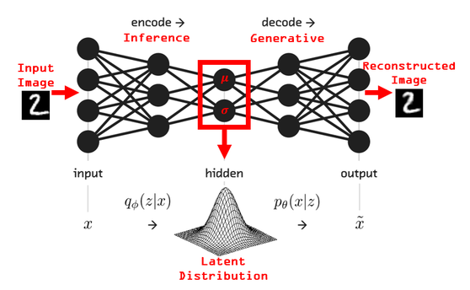
Donut Architecture

Slide 12
Donut : M-ELBO loss function
Donut Output : Score (Not Final Prediction)

Slide 13
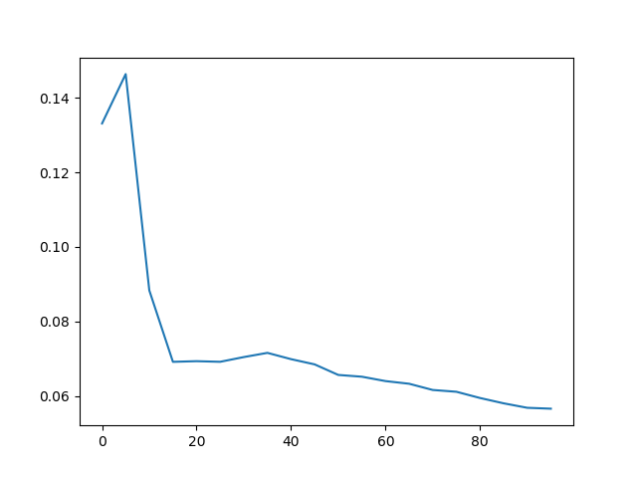
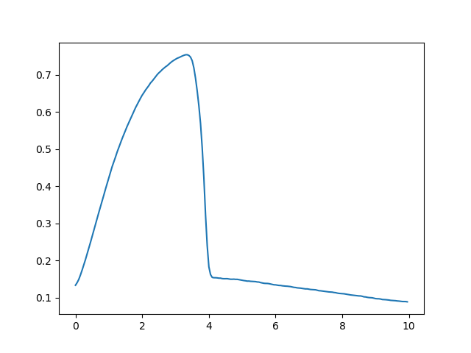
F1 Score Optimization using Custom Thresholds
Final Score on Test Set : 0.355

Slide 14
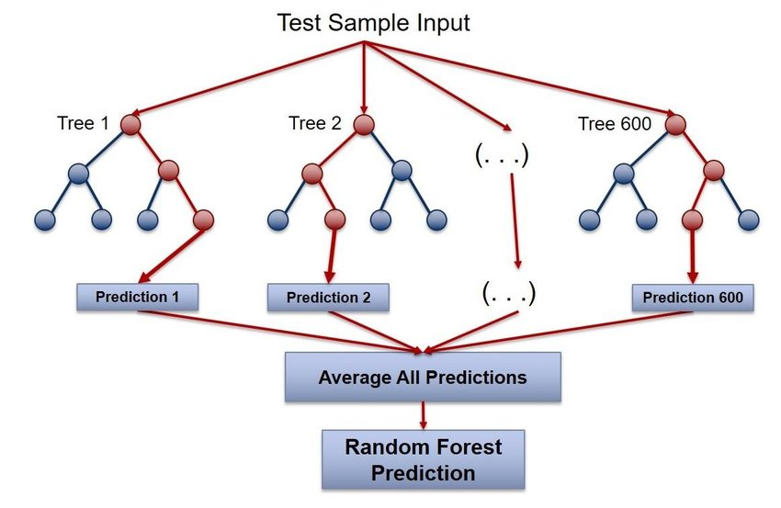
F1 Score Optimization using Random Forest
Final Score on Test Set : 0.55

Slide 15
DEEP FEEDFORWARD NETWORK

Slide 16
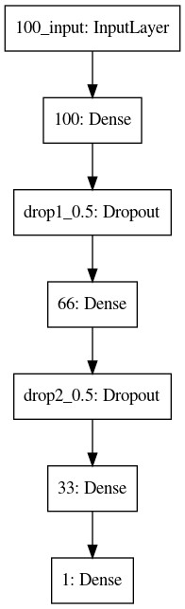
Model Architecture
1. Feature Engineering
KPI value graph is subsampled (1 minute period)
Slope is taken for each period
2. Deep Feedforward Network
Takes input as slopes at each timestamp
Final Score on Test Set : 0.61

Slide 17
Final Ensemble : Donut + DFN
Make a final submission file
Best f1 score on train set
Donut vs DFN
Final Score on Test Set : 0.661

Slide 18
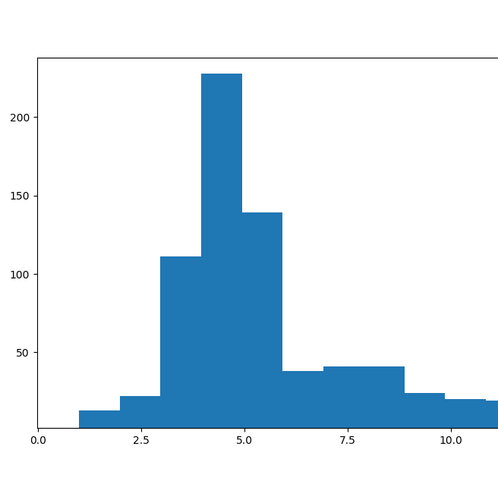
Evaluation Script Trick
Try to improve Precision by removing excess zeros
Final Score on Test Set : 0.677 (+0.016)

Slide 19
RESULTS

Slide 20
RESULTS
Model Name | Evaluation F1 Score on Test
Donut + Custom Threshold | 0.355
Donut + Random Forest | 0.55
Deep Feedforward Network | 0.61
Donut_RF + DFN | 0.661
Donut_RF + DFN (Eval Script Trick) | 0.677

Slide 25
Models Trained
Donut
Deep Feedforward Network
Ensemble (Donut + DFN)

